Slide 1
Mitigating DDoS attacks in Named-Data Networking (NDN)

Slide 2
Motivation
(Distributed) denial of service (DoS) attacks are significant threats to the current Internet
NDN architecture prevents conventional (D)DoS attacks
impossible to spoof IP address or launch a reflector attack
not as easy to target a specific host
NDN may be exposed to new types of attacks
interest flooding
network resource exhaustion
router’s resource exhaustion
cache, content poisoning, and potentially others undiscovered yet attack vectors
Interest flooding

Slide 3
Scope of the work / Attack model
Scope of the current work is limited to Interest flooding attacks
similar to IP packet flooding attack, major threat on the Internet
targeting both the core network and the content publishers
Attack model of Interest flooding
target:
NDN routers,
network channels
content producers (publishers)
action:
expressing a large number of Interests for (non-)existing Data from a specific namespace or a broad set of namespaces
effect:
resource (CPU, memory, bandwidth, etc.) exhaustion,
PIT overloading
Assumptions
attack interests do not bring data back
the most destructive attack on routers’ resources
models attacks on NDN networks with finite set of content
interests to “static” content cannot DDoS targeted network (caches will prevent that)
Attackers know prefix served by the target producer
There are no misbehaving routers

Slide 4
Work directions
NDN-specific methods can (should) be used to mitigate NDN-specific attack
Intuition
Every Interest should bring Data
Unsatisfied Interest is a red flag
future related Interest can (should) be dropped earlier

Slide 5
Methodology
Simulation-based experimentation
ndnSIM modular NDN simulator
http://ndnsim.net
different scale topologies
binary trees (3, 31, 128 nodes)
worst-case evaluations
search for the best mitigation technique
10Mbps links
propagation delays randomized from range 1-10ms
Emulation-based verification

Slide 6
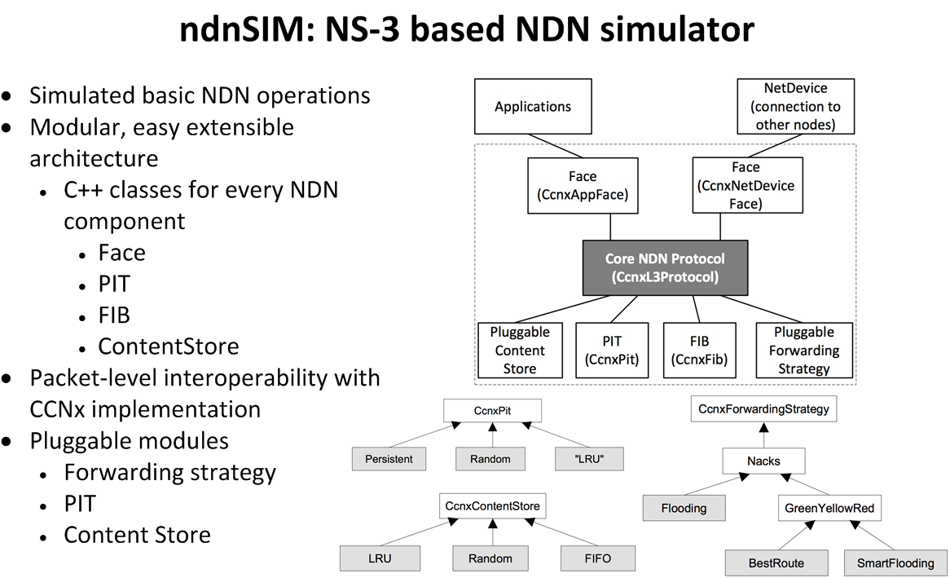
Brief intro to ndnSIM

Slide 7
Explored DDoS mitigation algorithms
PIT limits respecting physical link bandwidth (bandwidth-delay product)
Interest queuing with weighted round robin
probabilistic Interest accept
dynamic Interest limit adjustments

Slide 8
PIT limits respecting link bandwidth
NDN’s Interests/Data form a balanced receiver-driven flow
Number of Interests defines upper limit on Data packets
limiting number of Interests limits number of Data
the number of pending Interests to fully utilize channel with data packets
don’t forward Interests that cannot be satisfied

Slide 9
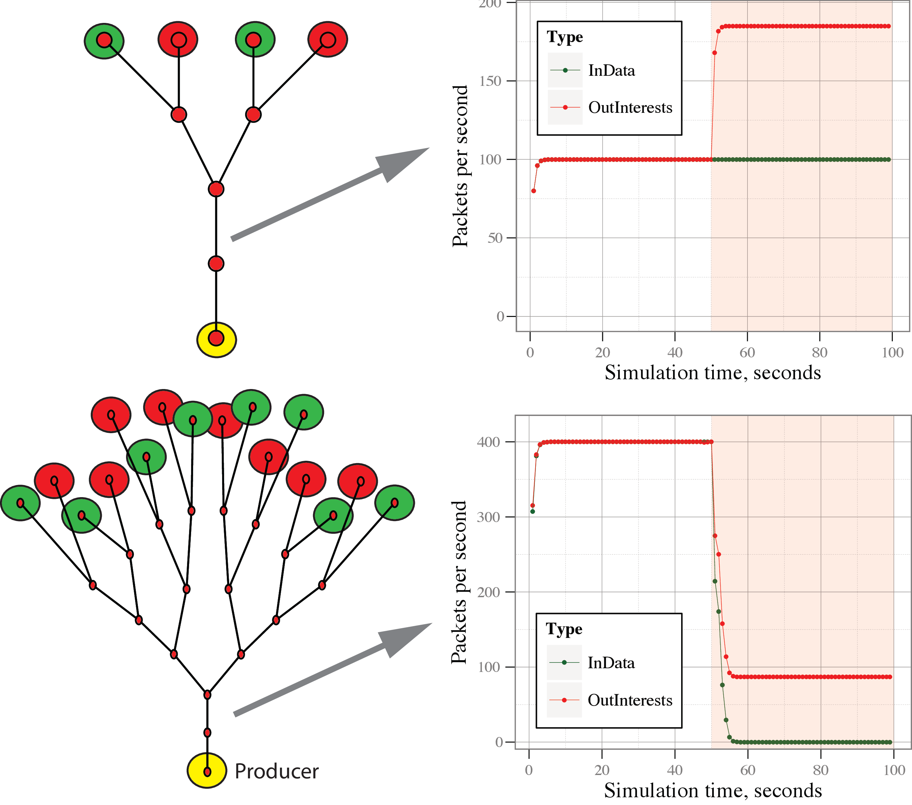


PIT limits respecting link bandwidth. Results
Prevent routers’ resource overutilization
Works in some cases
attacker cannot inject excessive number of interests
Makes attack worse in most of the other cases
no basis to distinguish “good” Interest from “evil”
“good” Interests compete with “evil” for PIT slot

Slide 10
Interest queuing with weighted round robin
“Reactive”: Interest queuing and “fair” PIT entries distribution
when Interest comes on face
subject to (per-prefix/per-face) pending Interest limit
if limit is not reached, accept Interest and create PIT entry
If limit is reached
“buffer” Interest in per-outgoing face queue (within per-incoming face sub-queue)
get satisfaction ratio for Interests on the face
set weight for per-incoming face sub-queue proportional to satisfaction ratio
when new PIT slot becomes available
accept and create PIT entry for an Interest from queue
subject to weighted round robin policy

Slide 11
Interest queuing with weighted round robin
All Interest need to be processed
similar Interests suppressed
Interests for local or cached content should be answered without additional queuing
Queuing assumes presence of Interest limits
per-face
per-prefix
Queuing makes sense only on outgoing direction (outgoing face queue)
Only from on outgoing face knows when a new slot becomes available
Interest should be enqueued after FIB lookup, before actually forwarding
“post-FIB” / “pre-send” queue
Outgoing face queue can implement “fairness” policies
per-incoming-face “fairness”
priority queue with virtual time, or
several per-incoming-face sub-queues
Time Interest is allowed to be in a queue should be limited
less than interest lifetime, otherwise there will be not state for Data return

Slide 12
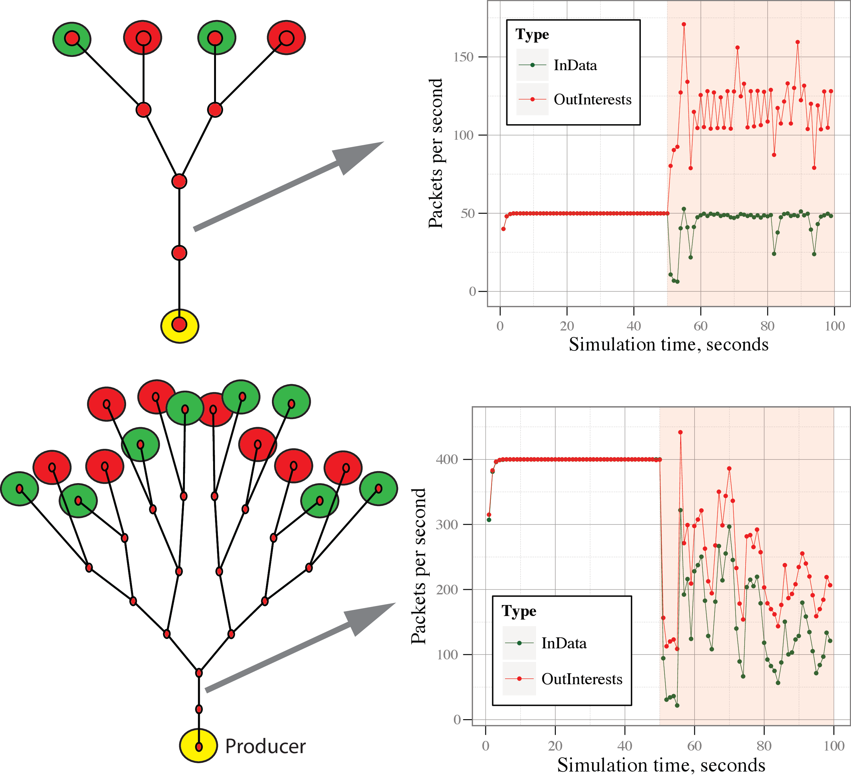

Interest queuing. Results
Interest “queues” are mostly underutilized
weighted round robin doesn’t work effectively
round robin gives per-incoming face fairness
Queue lifetime needs to be smaller than Interest lifetime
Partially works
during an attack, legitimate users can still get something
attackers receive their “fair” share of resources

Slide 13
Probabilistic Interest acceptance
Proactively (probabilistically) reject “bad” Interests
when Interest comes on face
“accept” if the number of received interest on this face is less than a predefined threshold, otherwise
get satisfaction ratio for Interests on this face
total or per-prefix (FIB, PIT)
if satisfaction ratio close to 100%
“accept” interest and create PIT entry
if satisfaction ratio < 100%
“accept” interest with probability proportional to satisfaction ratio
if satisfaction ration is 0%
“accept” interest with a low (“grace”) probability
All “accepted” Interests are still subject to (per-prefix/per-face) pending Interest limit

Slide 14
Interest satisfaction rate statistics module
recorded events
incoming Interest
Interest timeout (unsatisfied Interest)
incoming Data packet (satisfied Interest)
event granularities
exponential weighted moving average (similar to CPU load averages on *nix)
~5sec window: exp (-1.0/5.0)
~30 sec window: exp (-1.0/30.0)
~60 sec window: exp (-1.0/60.0)
per-prefix per-interface
per-prefix only, per-interface only
Properties:
child node stats aggregated to parent
total stats aggregated at the root
pruning zero-stat nodes and branches
Stats
Interest Stats
Prefix stats
5sec
30 sec
60 sec
Incoming
Satisfied
Timed out
Total
Per in face
Per out face
NDN router’s per-prefix statistics tree
/
parc.com
ucla.edu
...
ilya
alex
...
...
...

Slide 15
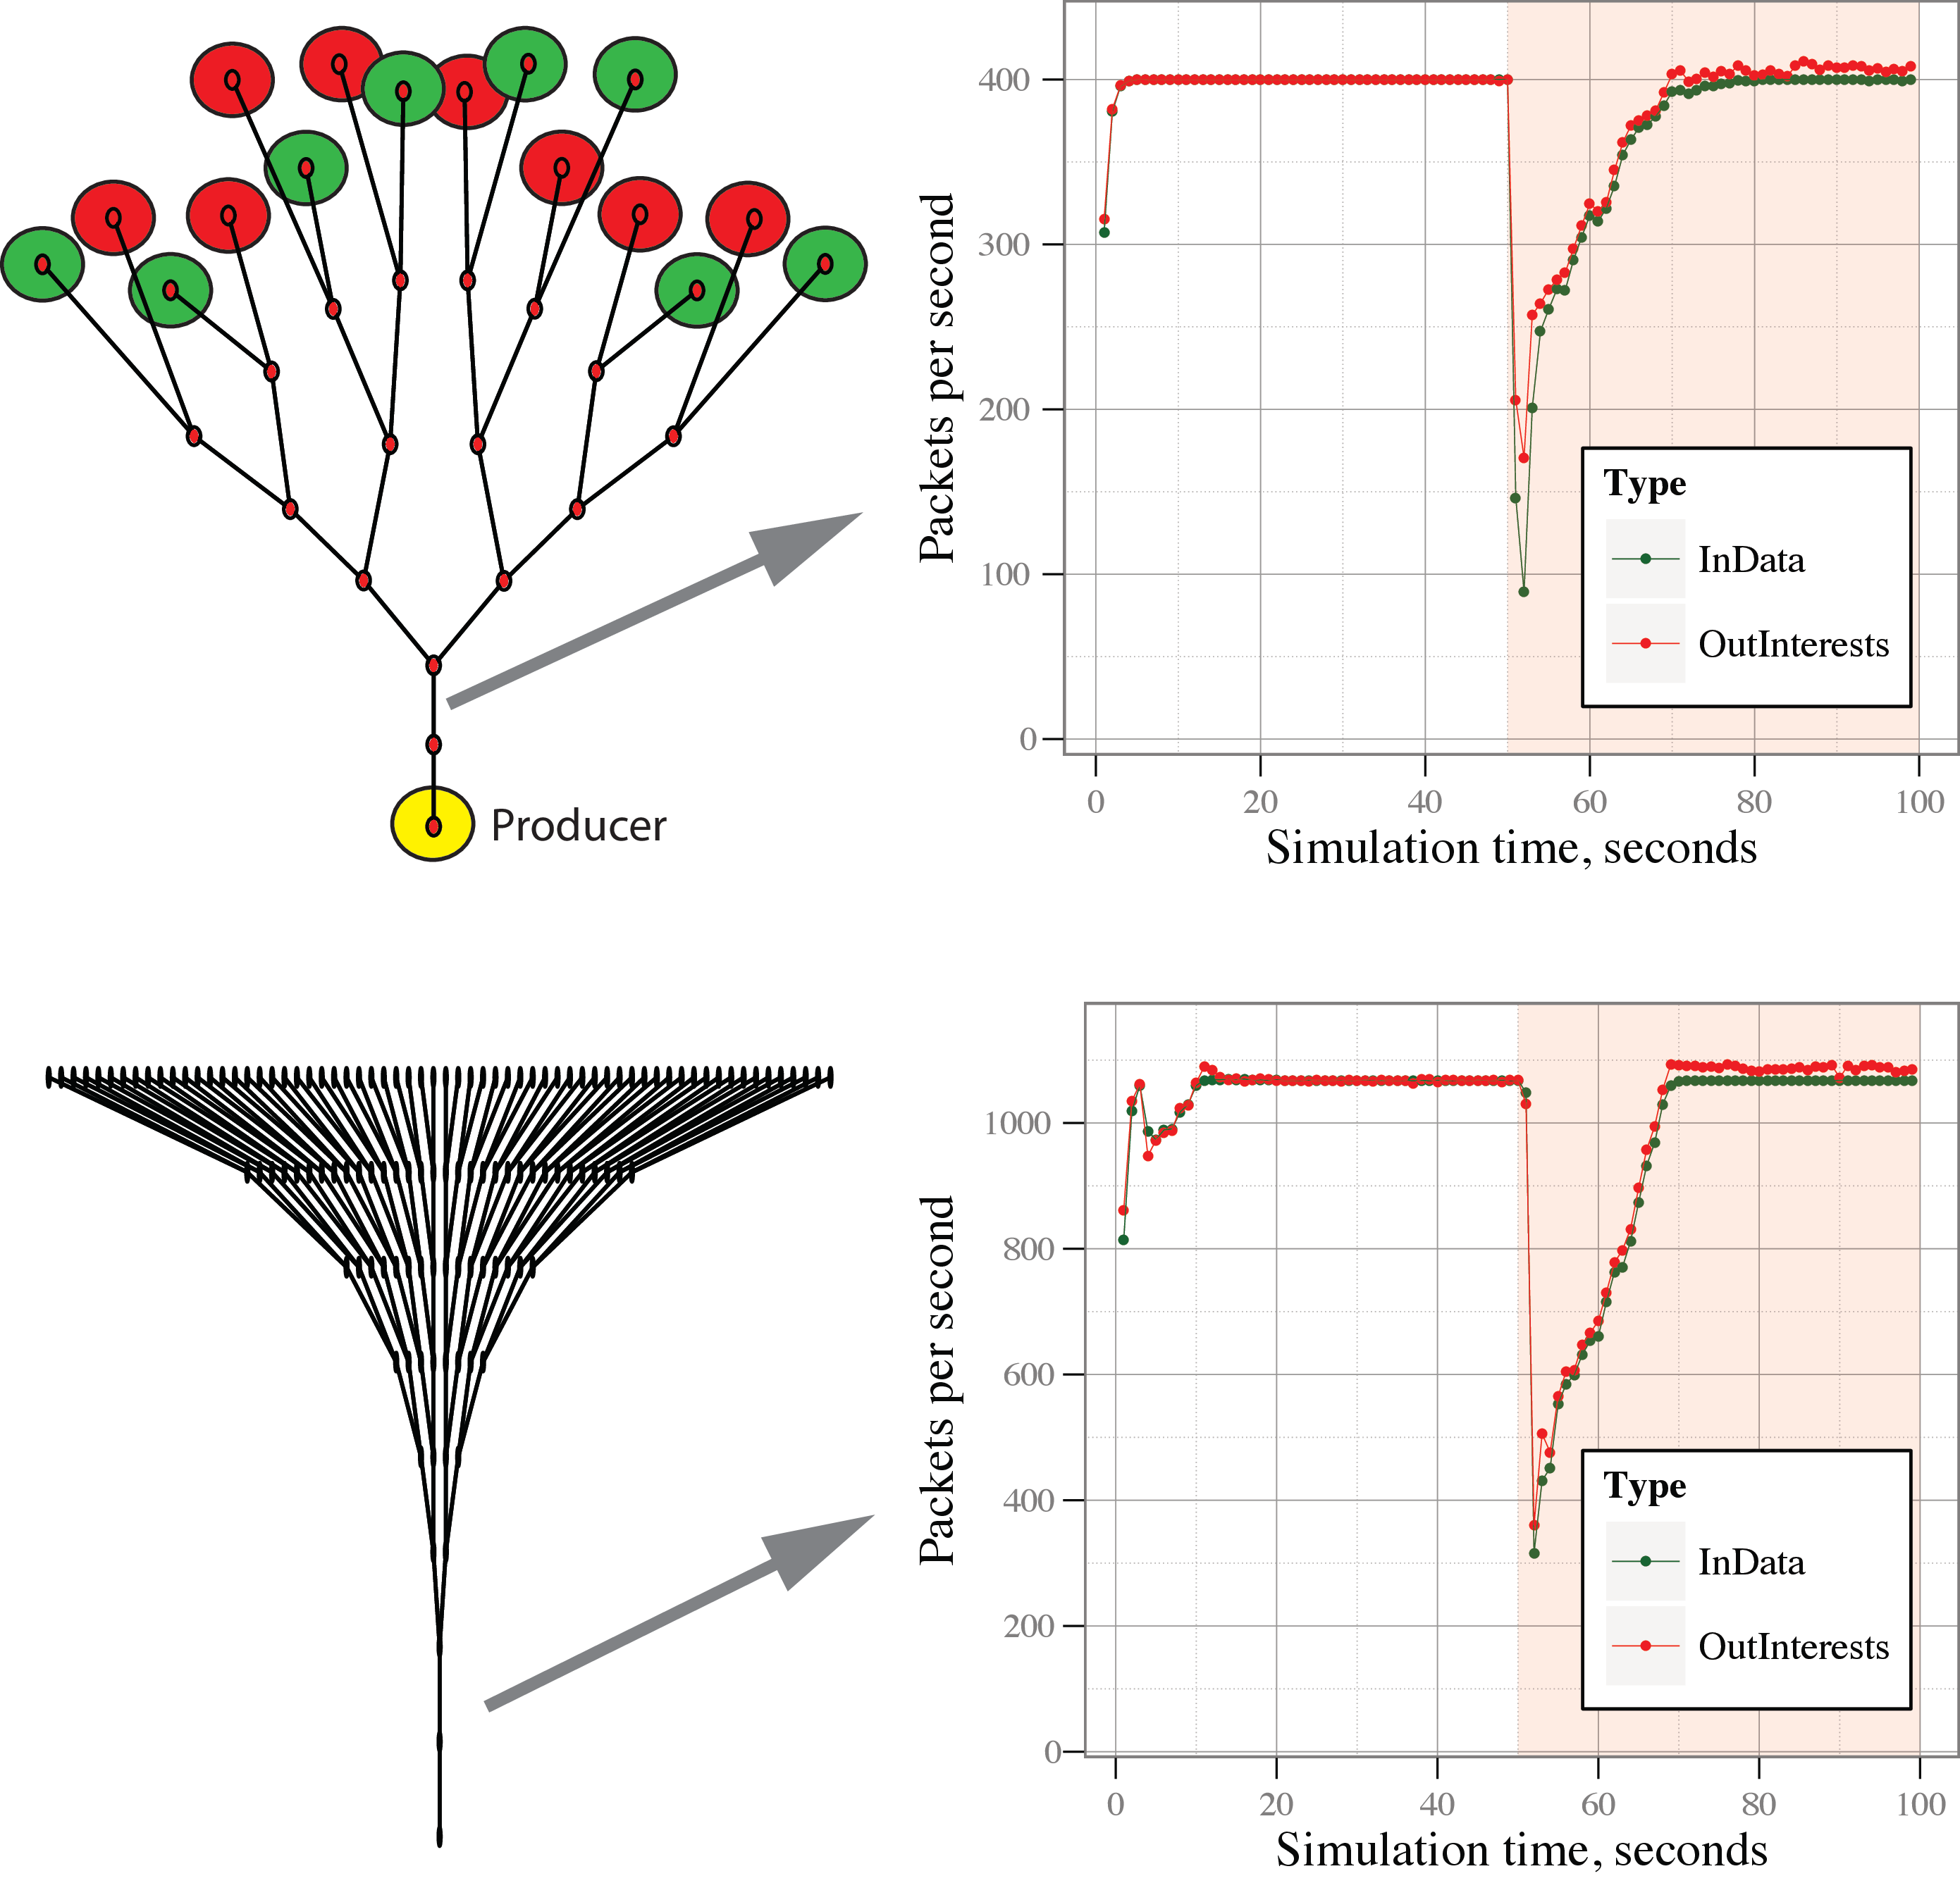
Probabilistic Interest acceptance. Results
“Proactive” accept/reject may result in under-acceptance of interests
When satisfaction ratio is 0%, there is a need to accept some number of “probe” Interests
unfortunately, the amount of needed “probe” Interests for adequate performance depends on the topology and traffic patterns
Works, but only on certain topologies and parameters

Slide 16
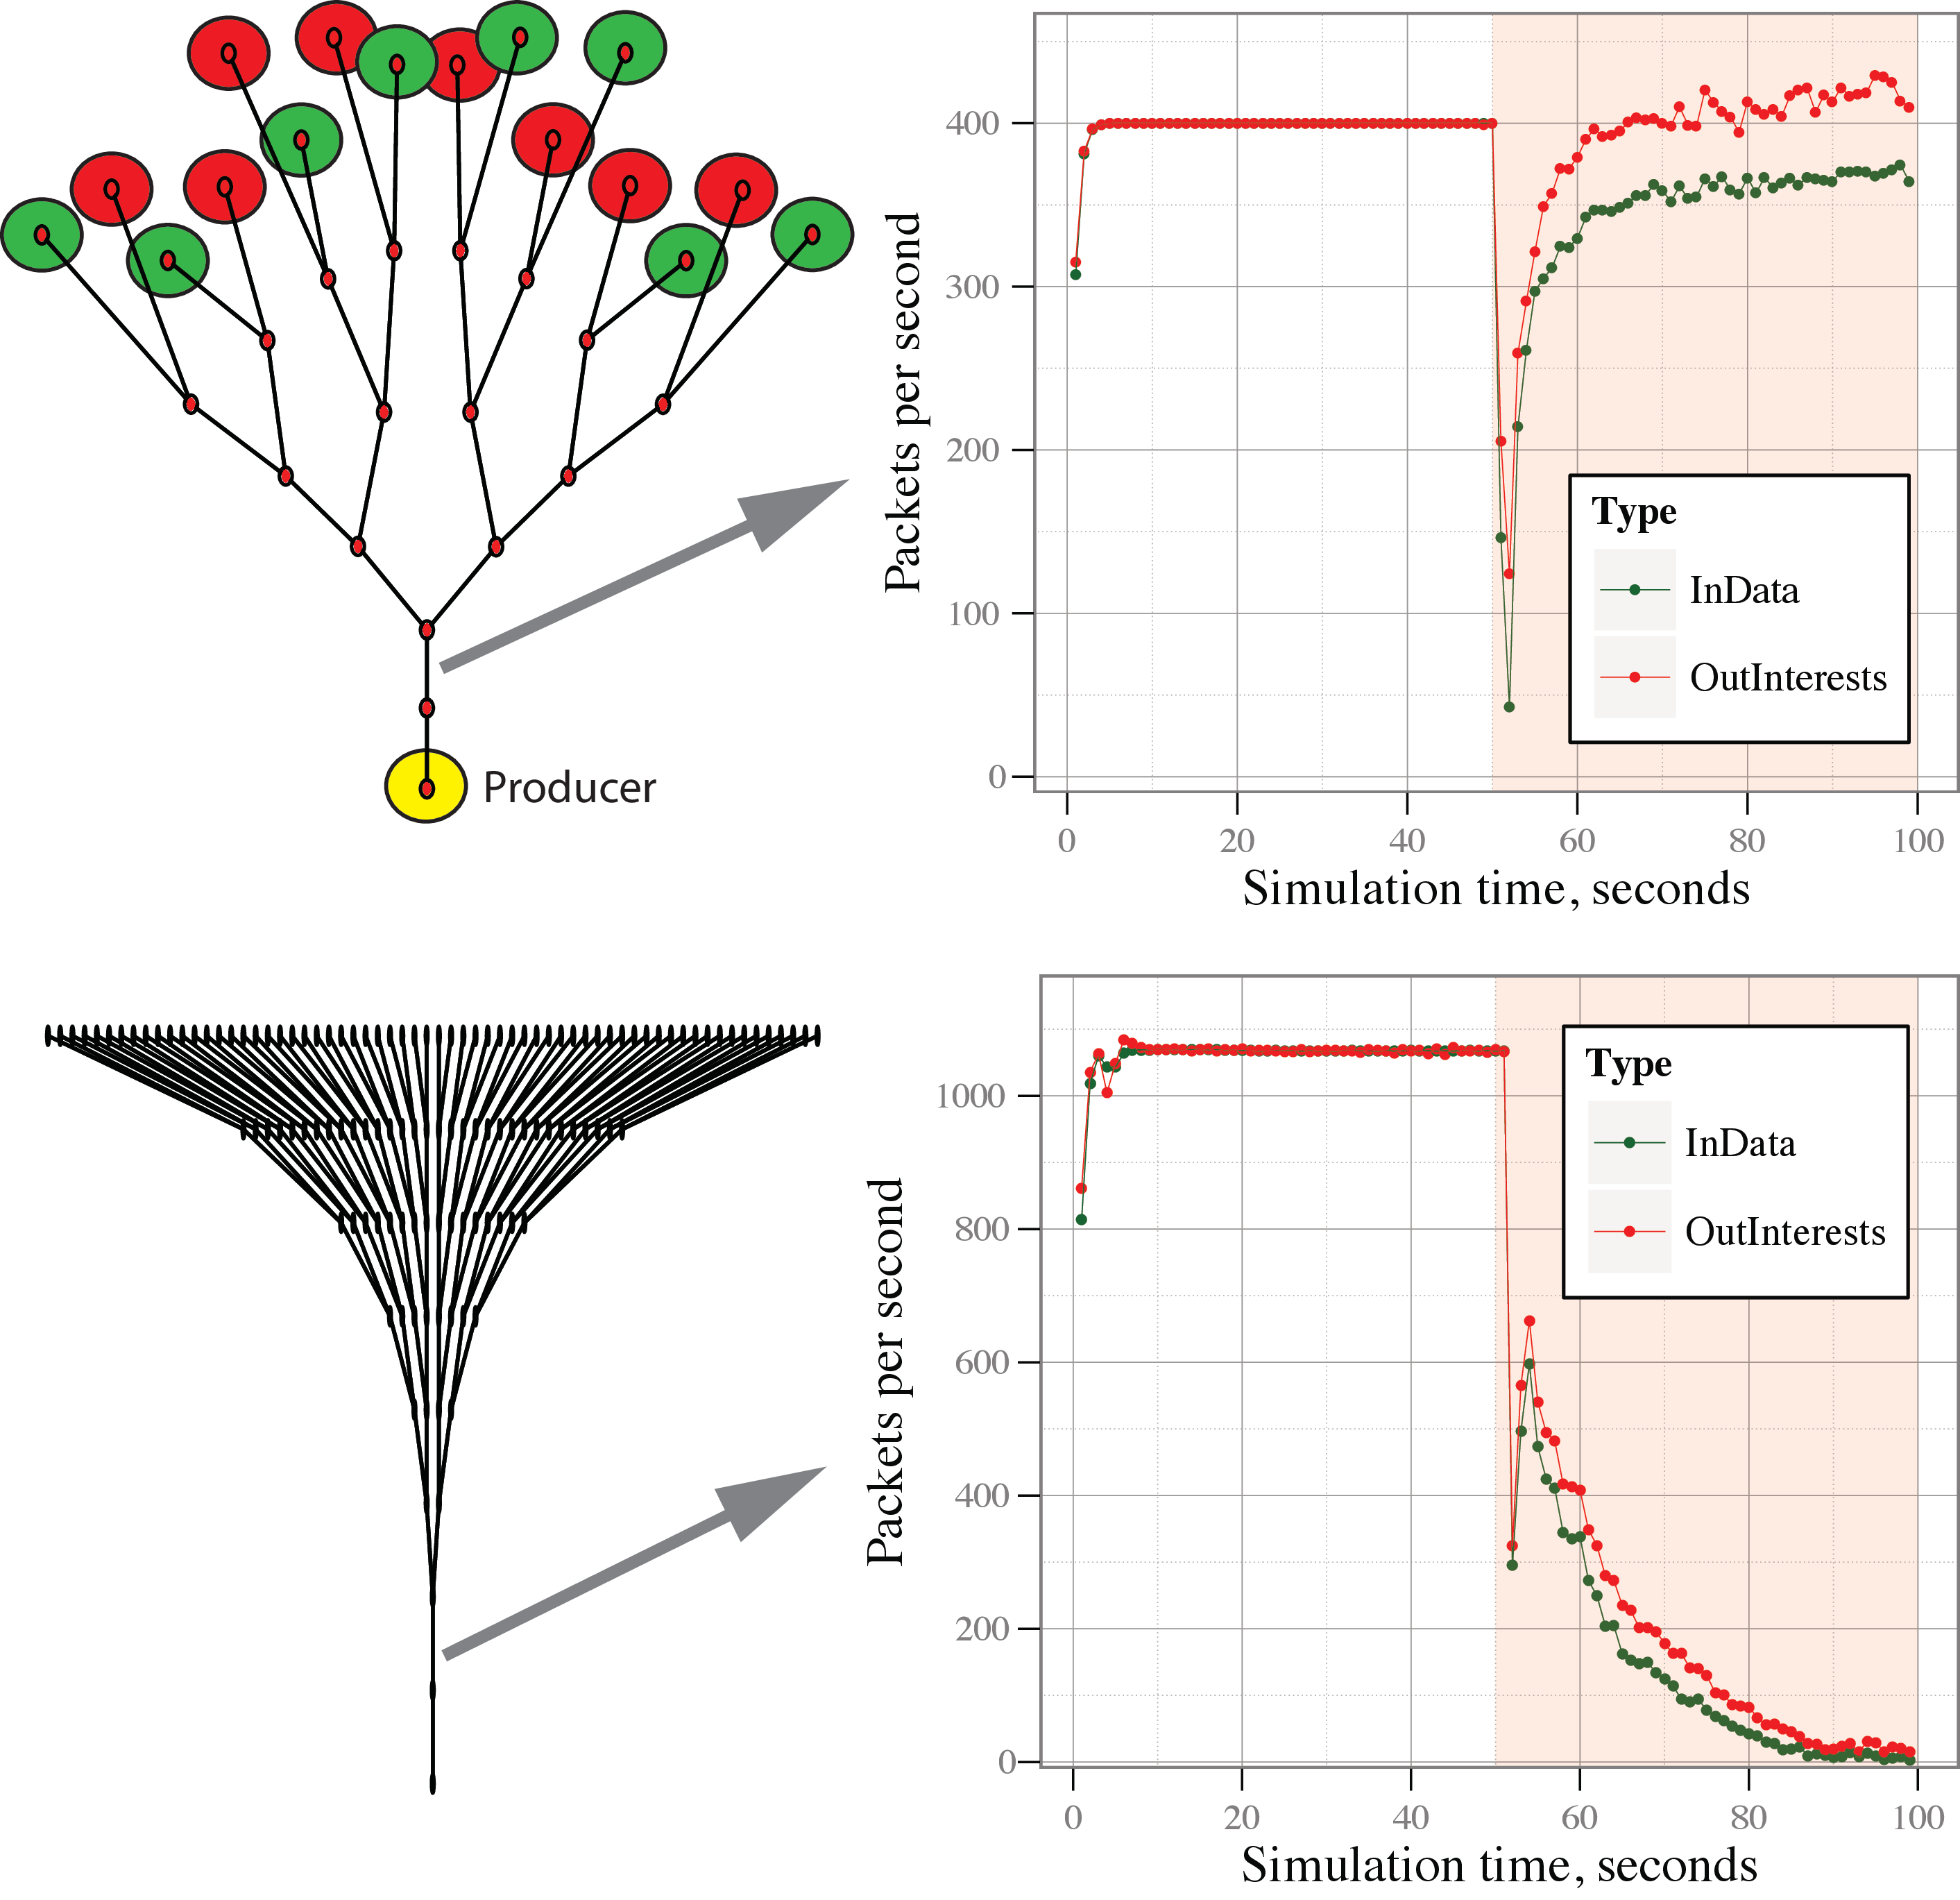
Probabilistic model. Effect of wrong parameters
Performance may suffer significantly if parameters of the probabilistic model are adjusted incorrectly
“grace” acceptance increased from 1% to 5% compared to previous slide

Slide 17
Dynamic Interest limit adjustments
Incorporate “reactive” PIT management
Interests over the limit are enqueued and processed in per-incoming face “fair” fashion
every second
for every FIB prefix
for all available faces
get satisfaction ratio for the face
announce limit on the face proportional to the satisfaction ratio
announced limit is at least 1
sum of all announced limits is at least equal to sum of output limits

Slide 18
Dynamic limits. Transitions during attack
Just before the attack
After the attack
Stabilized after the attack
Satisfaction rates
Satisfaction rates
Satisfaction rates
NA
1.0
1.0
0.0
1.0
0.0
1.0
1.0
NA
0.0
1.0
0.0
1.0
1.0
0.5
0.5
0.9
0.9
1.0
1.0
1.0
1.0
1.0
1.0
Announced limits
Announced limits
Announced limits
50
50
50
25
25
25
1
25
50
25
25
1
50
50
25
25
45
45
50
50
50
50
50
50

Slide 19
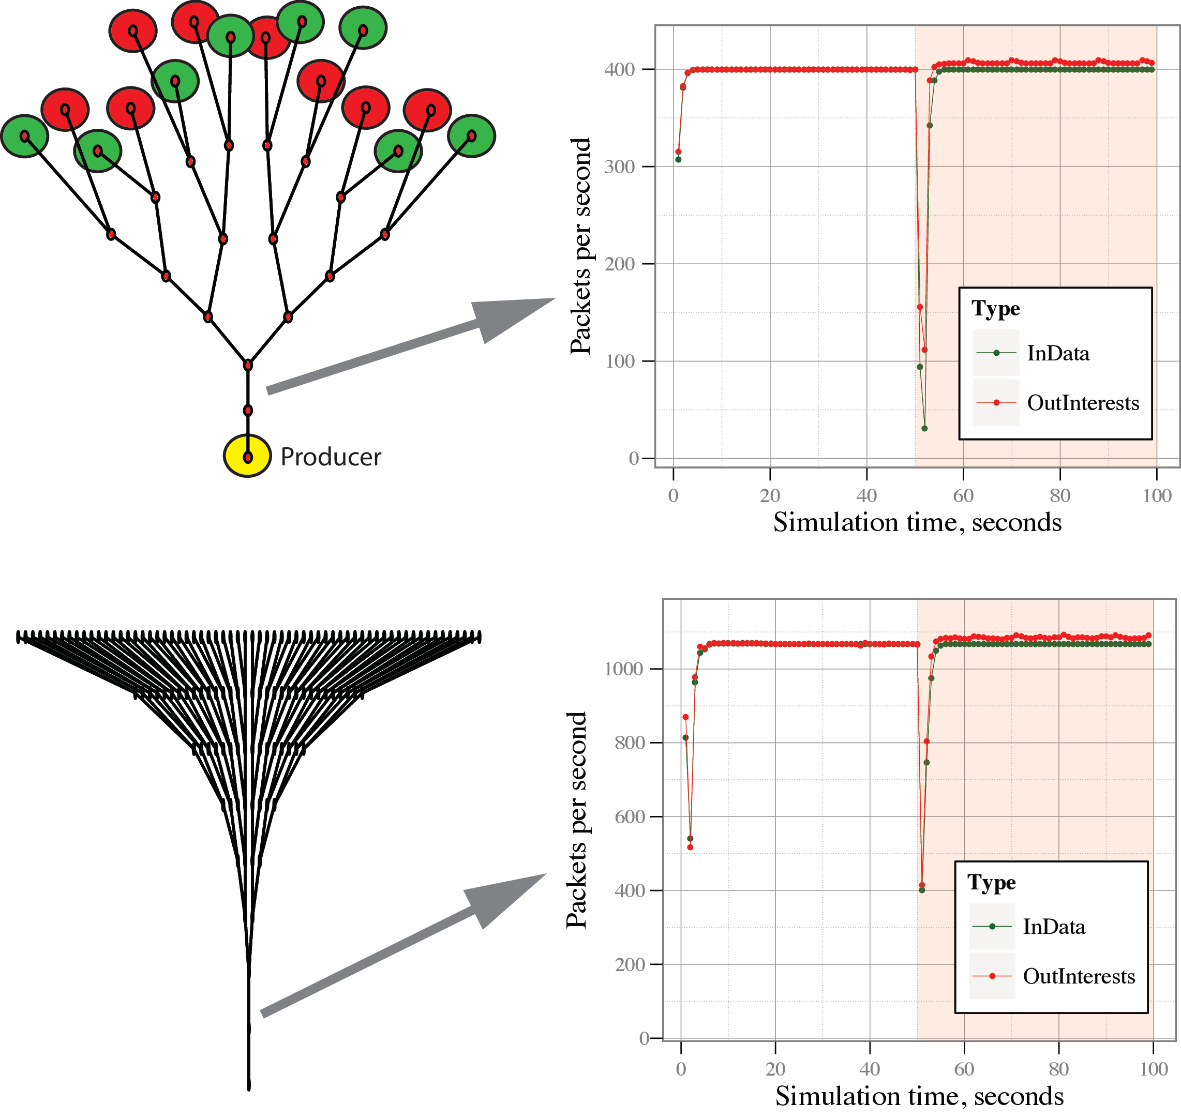
Dynamic limits. Basic evaluations
Does not require parameter tweaking
May not work for small BDP links
small windows don’t give much space for push-back
how to adjust window below 1?
Works with all topologies tested

Slide 20
Overall evaluation results
Four-level tree
Different number of attacker nodes
1-8 attackers (6%-50%)
Different DDoS mitigation algorithms
dynamic Interest limit adjustments
probabilistic Interest accept
Queues with weighted round robin
PIT limits respecting physical link bandwidth (bandwidth-delay product)
no limits

Slide 21
Interest satisfaction ratios
10-run averages for 50 seconds after the attack started

Slide 22
Reaction to the attack (satisfaction vs. time)
4 (25%) attackers
Notes:
95% confidence intervals

Slide 23
Questions

Slide 24
ndnSIM scalability numbers
Memory overhead (on average)
per simulation node
Node without any stacks installed
0.4 Kb
Node with ndnSIM stack (empty caches and empty PIT)
Without global routing controller
1.6 Kb
With global routing controller
1.7 Kb
Node with IP (IPv4 + IPv6) stack (for reference)
5.0 Kb
per PIT entry
1.0 Kb
per CS entry
0.8 Kb
Processing speed
~50,000 Interests per wall clock second (on single core 2.4 Ghz)
~35,000 Interests + Data combined per wall clock second
MPI support of NS-3
manual network partitioning
close to linear scaling with number of cores with good partitioning

Slide 25
Interest flooding mitigation
“smart” PIT management
“proactively” reject new interests based on recent interest satisfaction rate
interest queuing and “reactively” allocating “fair” share of PIT entries
per-outgoing, per-incoming face fairness
dynamic interest limits adjustments
node announce limits based on recent interest satisfaction rate statistics
variation of a well-known push-back mechanism
bandwidth-delay product (BDP) based interest limits
limit number of pending interests

